Slide 1
Deep Learning Course
Majid Nasiri Manjili
Shahid Rajaee Teacher Training University

Slide 2
Introduce
Majid Nasiri
B.sc : Electronic (Shiraz University of Technology)
M.sc: Artificial Intelegence (Shahid Rajaee Teacher Training University)
Email: mail.ai@yahoo.com
Web: https://github.com/m-nasiri

Slide 3
Topics
Introduction
Machine Learning Basics
Deep Learning Basics
Neural Network Basics
Installation Softwares
Tensorflow

Slide 4
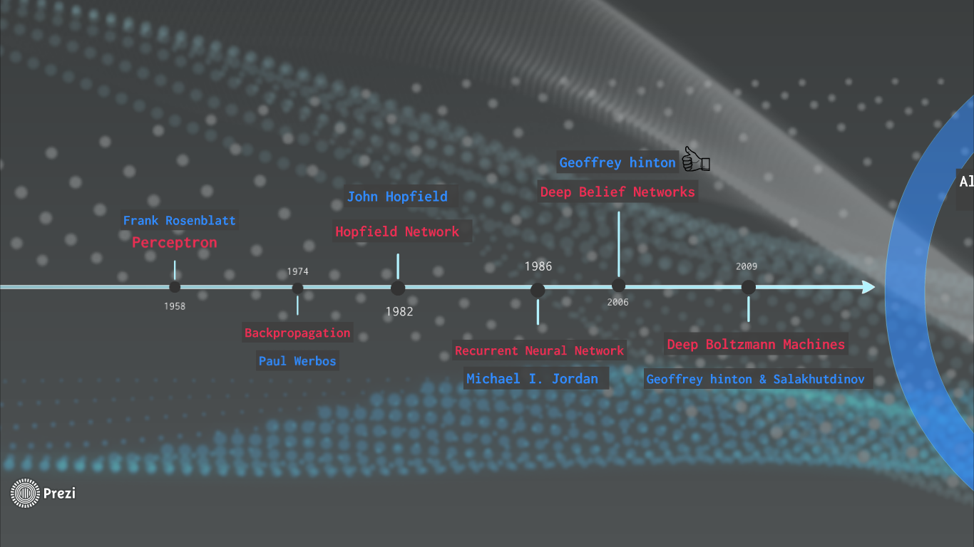
Introduction (History)

Slide 5
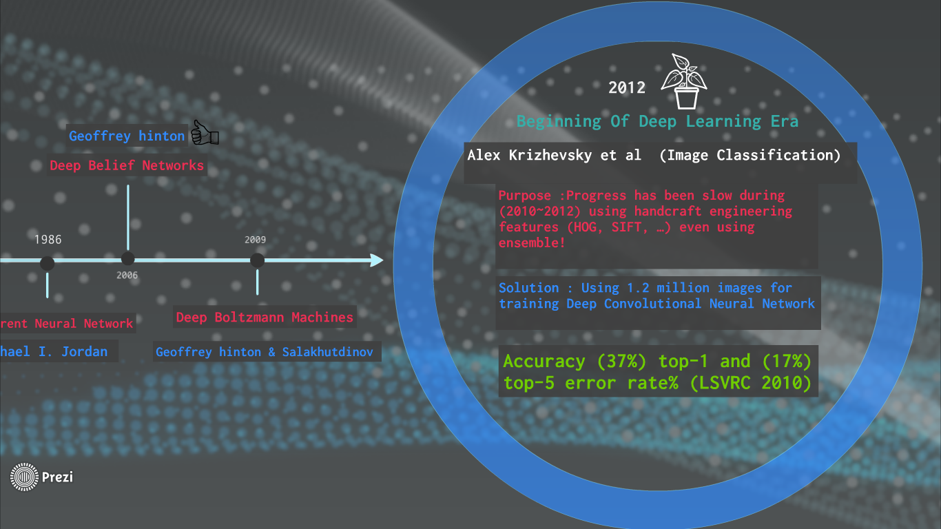
Introduction (History)

Slide 6
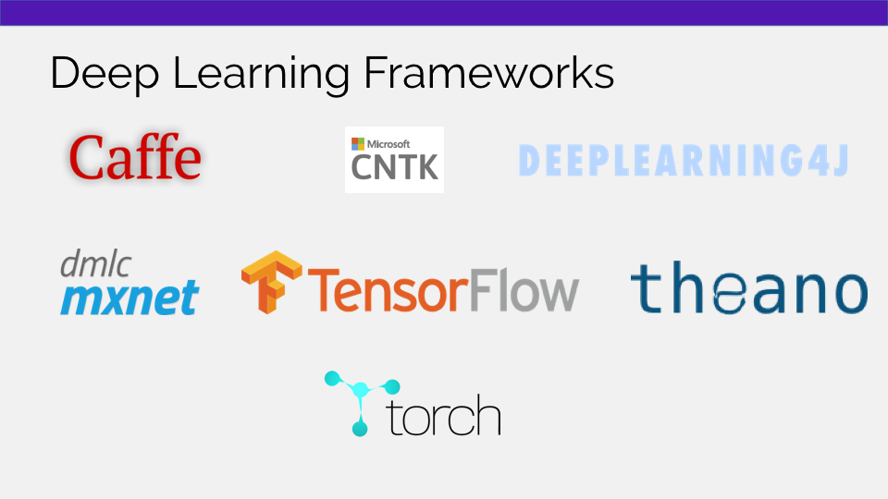
Introduction (History)

Slide 7
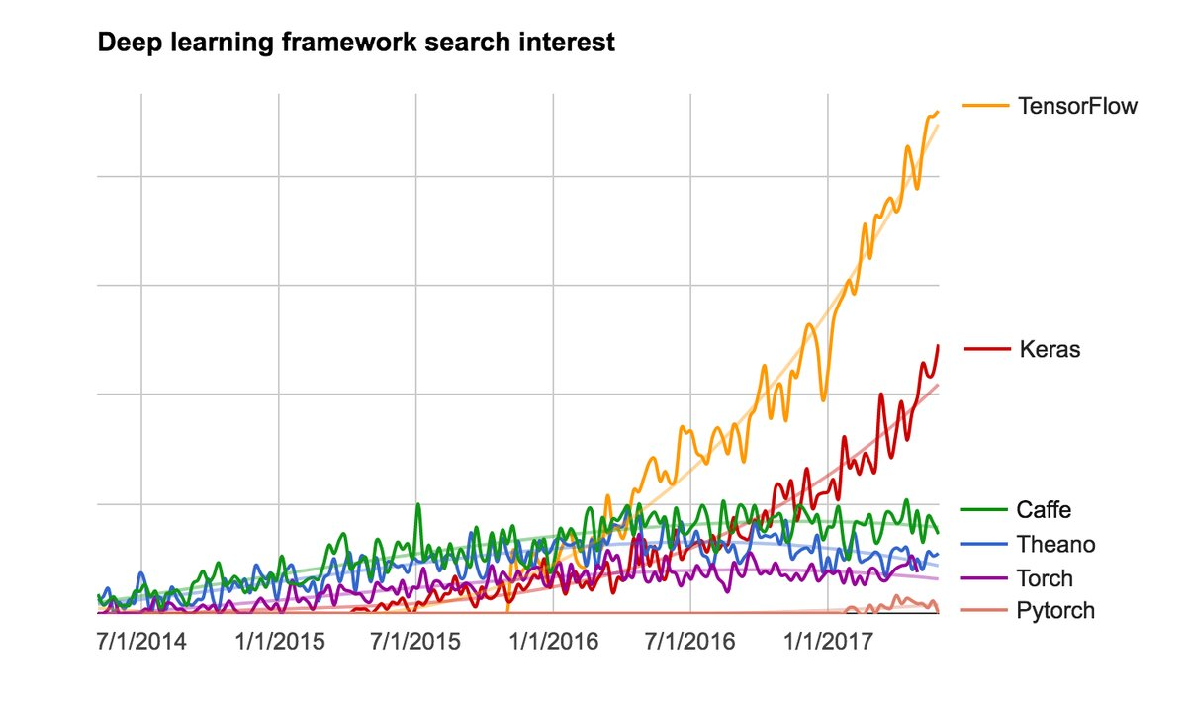
Introduction Why Tensorflow?
Google
Big Community
https://github.com/tensorflow

Slide 8
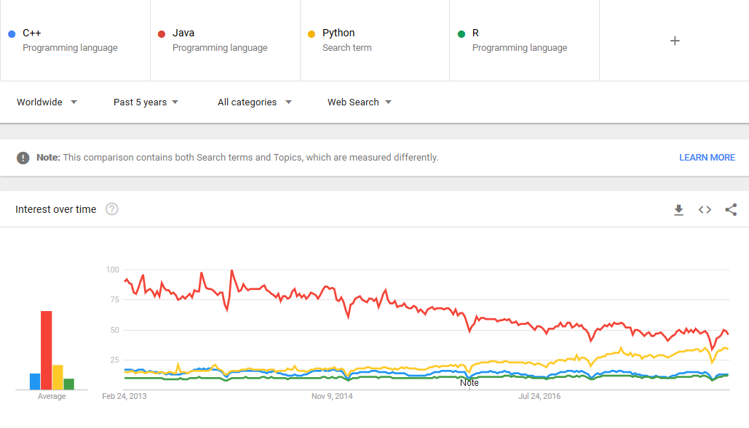
https://trends.google.com/trends/

Slide 9
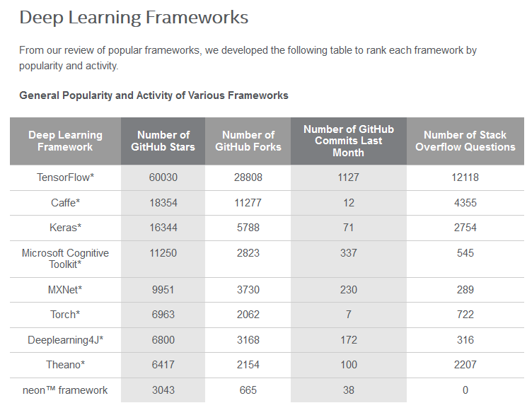
Introduction
https://software.intel.com/en-us/articles/hands-on-ai-part-5-select-a-deep-learning-framework

Slide 10
Machine Learning Basics
X
Y
x1 | y1
x2 | y2
... | ...
xN | yN
X = samples (raw data, featuers of raw data)
Y = labels
➢ DATASET MUST BE REPRESENTATIVE

Slide 11
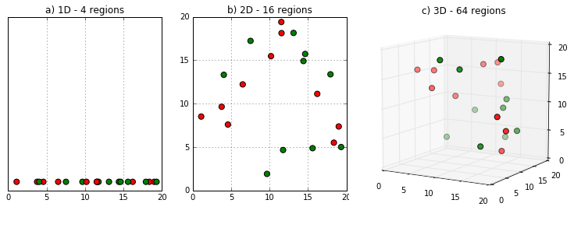
Machine Learning Basics
Model
X
Model Complexity Vs Number of Data
Curse of dimensionality
Y

Slide 12
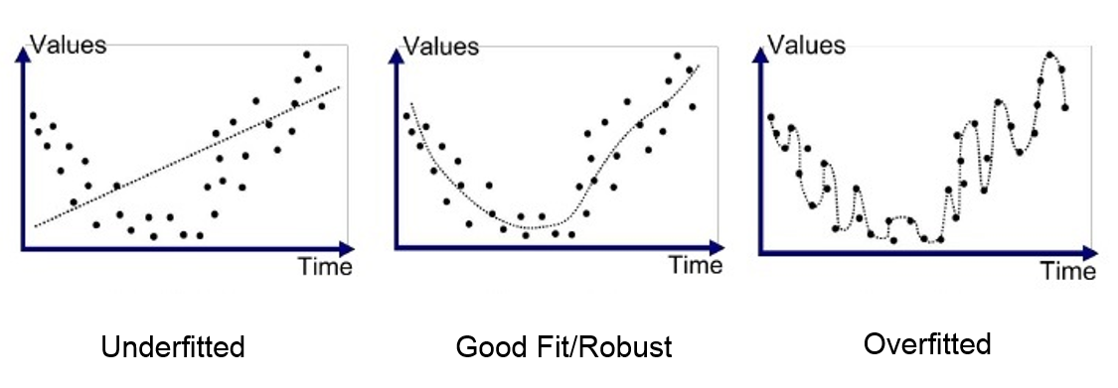
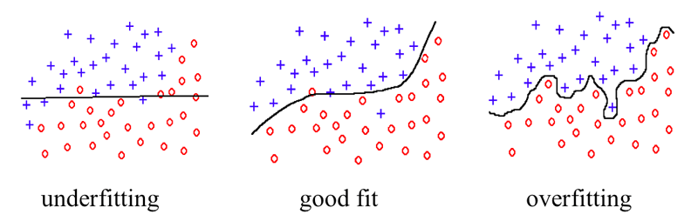
Machine Learning Basics
Overfit & Underfit (Regression - Classification Generalization

Slide 13
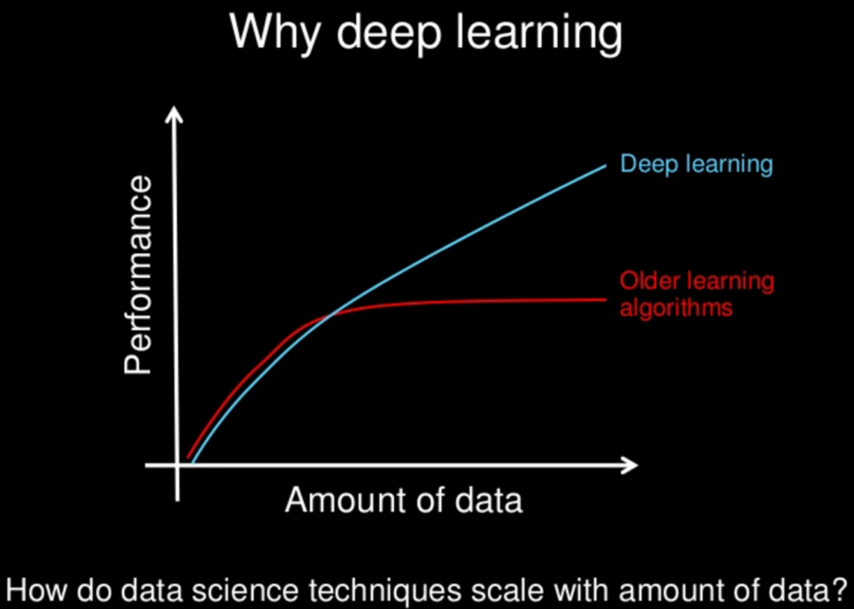
Machine Learning Basics Traditional vs Deep Approaches performance
Prepare More Data choose More Complex Model

Slide 14
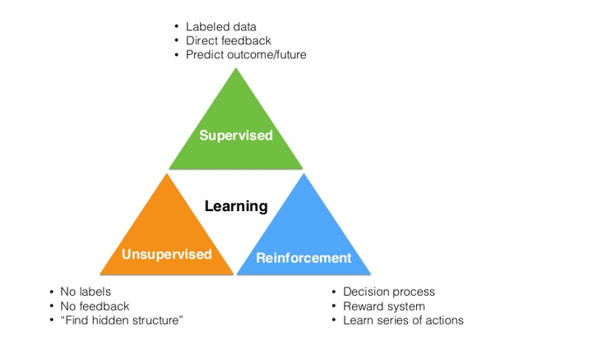
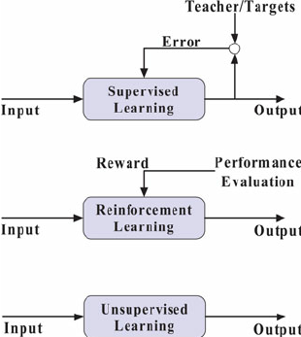
Machine Learning Basics Supervised vs Unsupervised vs Reinforcement
Wang, Shouyi & Chaovalitwongse, Wanpracha & Babuska, Robert. (2012). Machine Learning Algorithms in Bipedal Robot Control. Systems, Man, and Cybernetics, Part C: Applications and Reviews, IEEE Transactions on. 42. 728-743. 10.1109/TSMCC.2012.2186565.

Slide 15
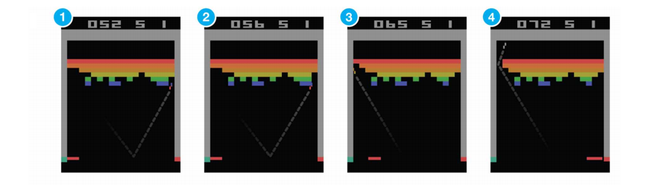
Machine Learning Basics Supervised vs Unsupervised vs Reinforcement

Slide 16
Deep Learning Basics
Traditional vs Deep Learning Systems Block Diagram
Different Classification Problems (singleclass, multiclass, multilabel, multitask)
Regression (linear Regression, logistic regression)
Deep Learning Problem Component (dataset, model, loss, opt, acc)

Slide 17
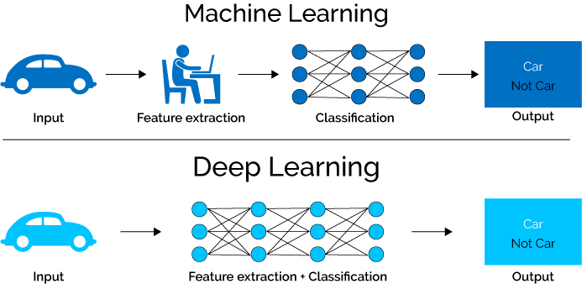
Deep Learning Basics Traditional vs Deep Learning Systems Block Diagram

Slide 18
Deep Learning Basics Different Problems
Singleclass Classification (Apple / Not Apple)
Multiclass Classification (Apple / Orange / banana / ...)
Multilabel Classification (Apple/ Not Apple)(Small/Big)
Multitask (Multiclass & Multilabel Classification)

Slide 19
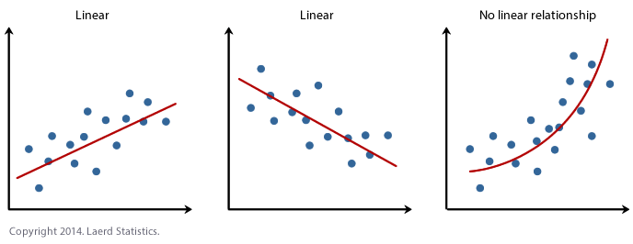
Deep Learning Basics Regression (linear Regression, logistic regression)
Linear Regression
Non-Linear Regression
https://statistics.laerd.com/spss-tutorials/linear-regression-using-spss-statistics.php

Slide 20
Deep Learning Basics Deep Learning Problem Component
Accuracy
labels
Dataset
samples
Model
(Feature Extraction + Classificcation)
Dataset
loss
opt
predictions
backpropagation

Slide 21
Neural Network Basics
Single Perceptron Model
Backpropagation
Optimization
MultiLayer Perceptron Model

Slide 22
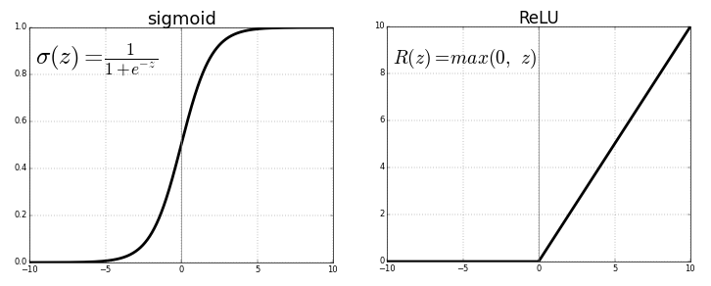
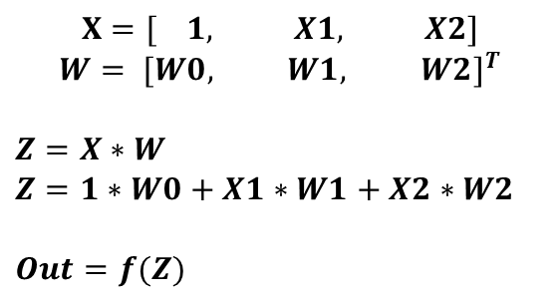
Neural Network Basics Single Perceptron Model
W0
W1
W2
$$X=[ 1, X1, X2]$$
$${W= [W0, W1, W2]}^{T}$$
$$Z=X∗W$$
$$Z=1∗W0+X1∗W1+X2∗W2$$
$$Out=f(Z)$$
1
X1
X2
f
Z
Out

Slide 23
Neural Network Basics MultiLayer Perceptron Model

Slide 24
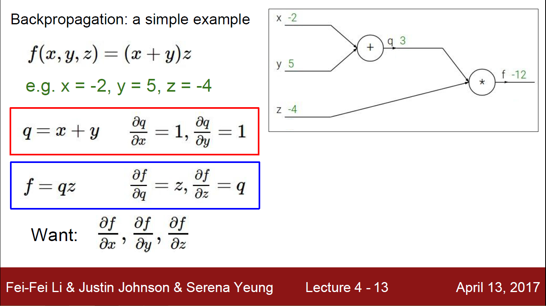
Neural Network Basics Backpropagation

Slide 25
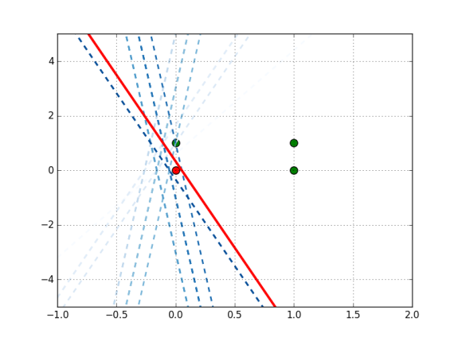
Neural Network Basics Backpropagation

Slide 26

Neural Network Basics Optimization

Slide 27
Neural Network Basics Optimization
Stochastic gradient descent
Momentum
Nesterov accelerated gradient
Adagrad
Adadelta
RMSprop
Adam

Slide 28
Neural Network Basics Optimization

Slide 29
Installation Softwares
Install Anaconda (Including Spyder + Python)
Install tensorflow, tensorflow_gpu

Slide 30
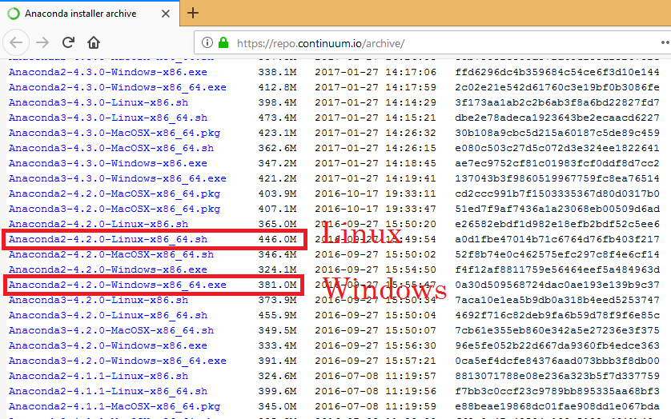
Installation Softwares Install Anaconda
https://www.dataquest.io/blog/pydata-windows/
https://repo.continuum.io/archive/

Slide 31
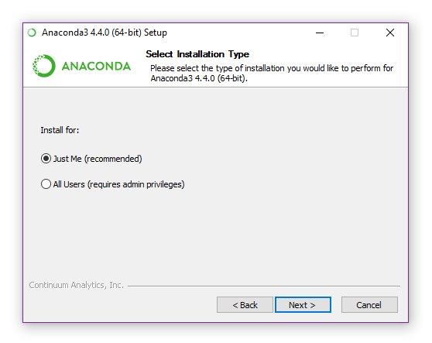
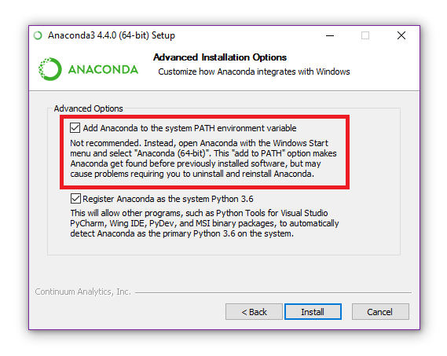
Installation Softwares Install Anaconda
Installation Guide https://www.dataquest.io/blog/pydata-windows/

Slide 32
Installation Softwares Install tensorflow Linux & Windows
Linux
download tensorflow-1.4.0-cp35-cp35m-manylinux1_x86_64.whl from
https://pypi.python.org/pypi/tensorflow/1.4.0
$ conda create –n tf14
$ source activate t14
$ pip install --ignore-installed --upgrade tensorflow-1.4.0-cp35-cp35m-manylinux1_x86_64.whl
Windows
download tensorflow-1.4.0-cp35-cp35m-win_amd64.whl from
https://pypi.python.org/pypi/tensorflow/1.4.0
$ conda create –n tf14
$ activate t14
$ pip install --ignore-installed --upgrade tensorflow-1.4.0-cp35-cp35m-win_amd64.whl

Slide 33
Installation Softwares Install tensorflow_gpu
https://github.com/m-nasiri/tensorflow/tree/master/tensorflow-gpu-install-ubuntu-16.04-cuda9.0-cudnn7.0

Slide 34
Tensorflow
Tensorflow Graph Components (Placeholder, Variables, Constant, Operation)
Simple tensorflow code
Simple regression project
Simple classification project
Assignment (Design A MLP Model for MNIST Dataset)

Slide 35
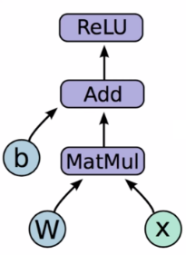
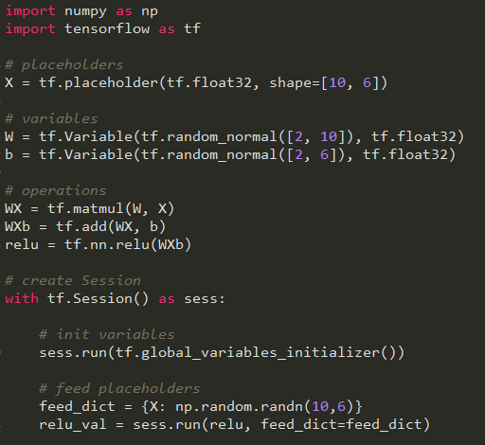
Tensorflow Tensorflow Graph Components
Operation
Operation
Operation
Variables
Variables
Placeholder

Slide 36
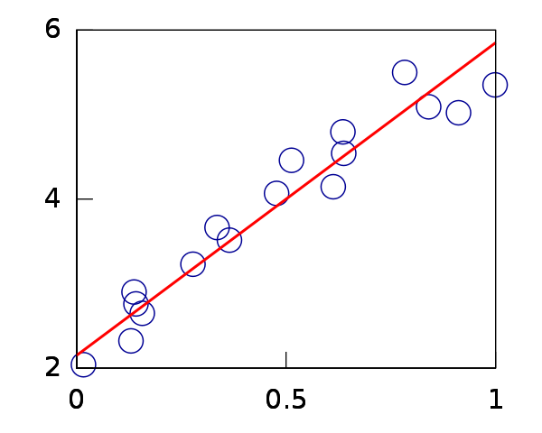
Tensorflow Simple regression
Find optimum line to model all samples

Slide 37
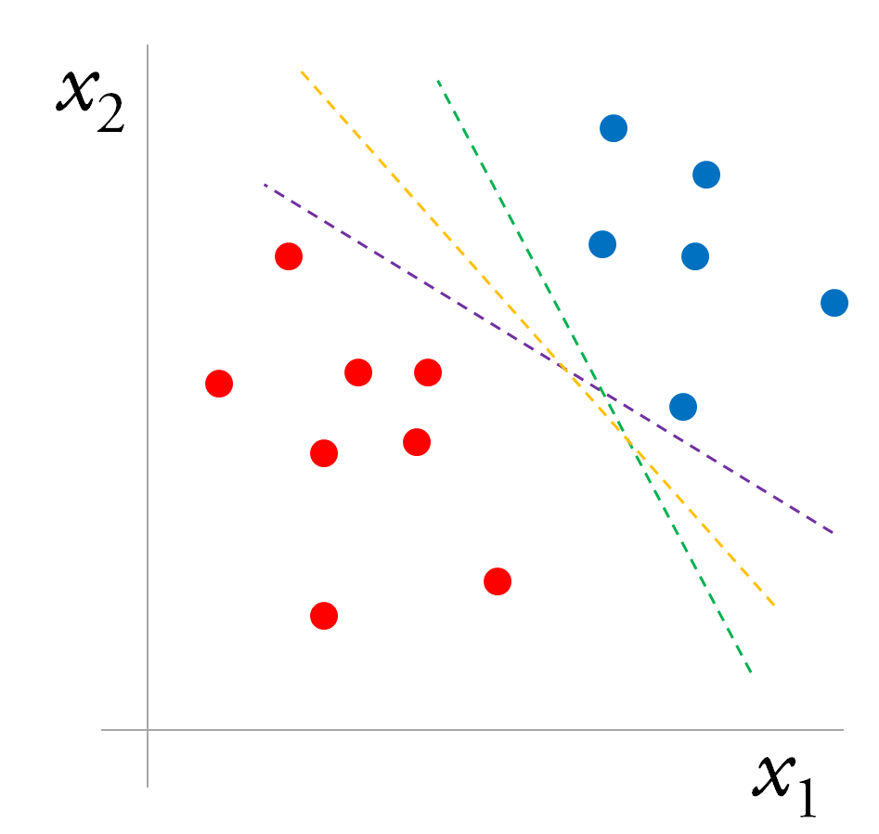
Tensorflow Simple classification
Optimize a line for classifiy
two classes

Slide 38
Tensorflow
Assignment (Design A MLP Model for MNIST Dataset)

